Slide 1
Dye-Sensitized Solar Cells
Цветосенсибилизиованные солнечные ячейки

Slide 2
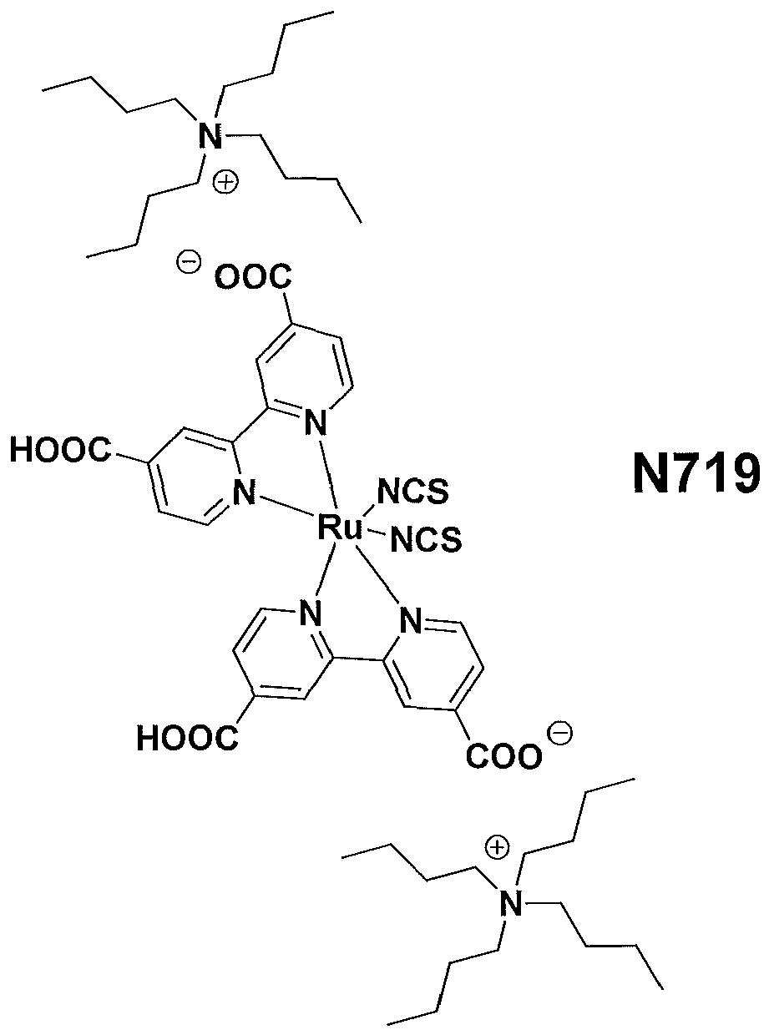

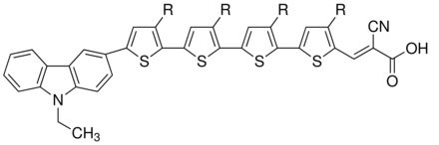
Dye-Sensitized Solar Cells
стекло
Цветосенсибилизированные солнечные
батареи (ячейки Гретцеля, DSSC)
TiO₂ d≈30 нм
LUMO
cb
h
HOMO
е
+
Анкер
Red (I₃⁻)
е
Ox (I⁻)
MK-2
сенсибилизатор
Pt
FTO (SnO₂·F)
FTO

Slide 3
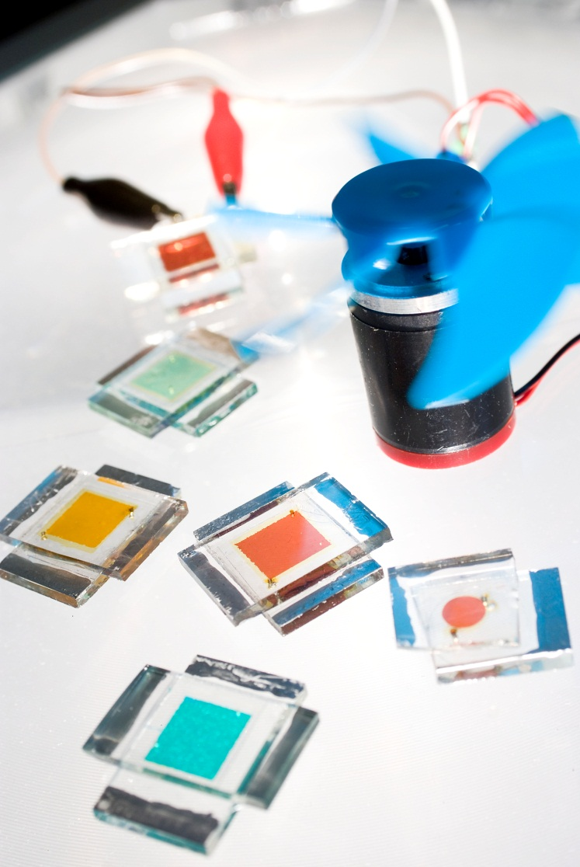
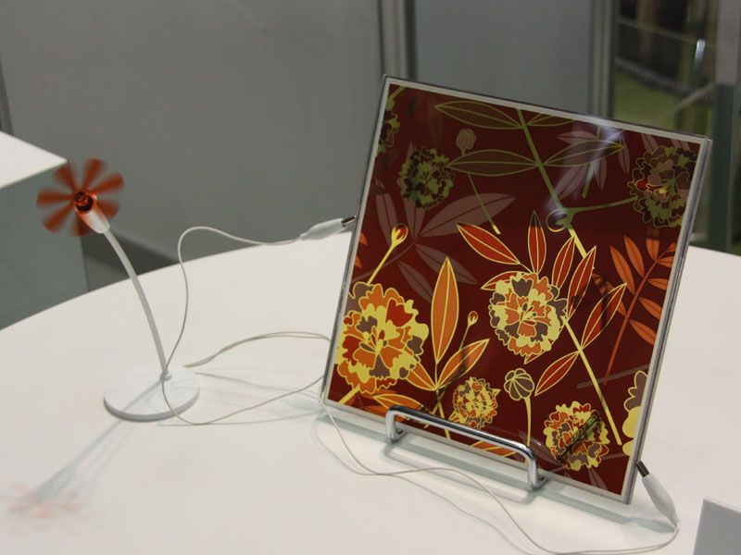
Dye-Sensitized Solar Cells
Sony Eco-Products 2008

Slide 4
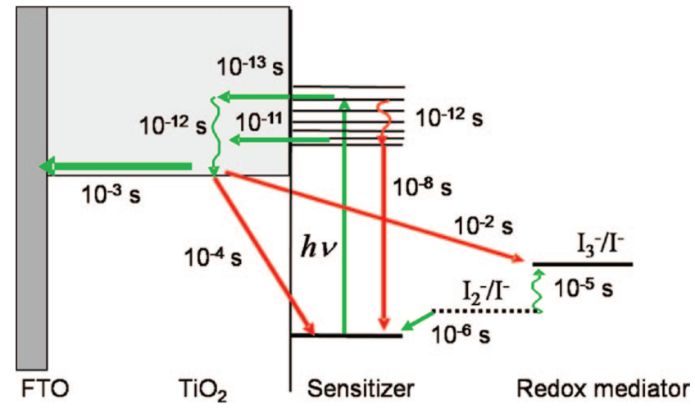
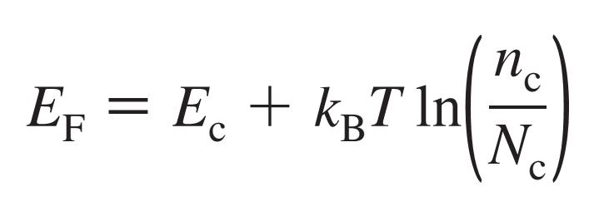
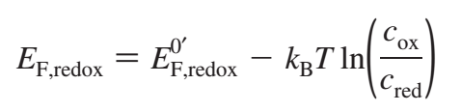
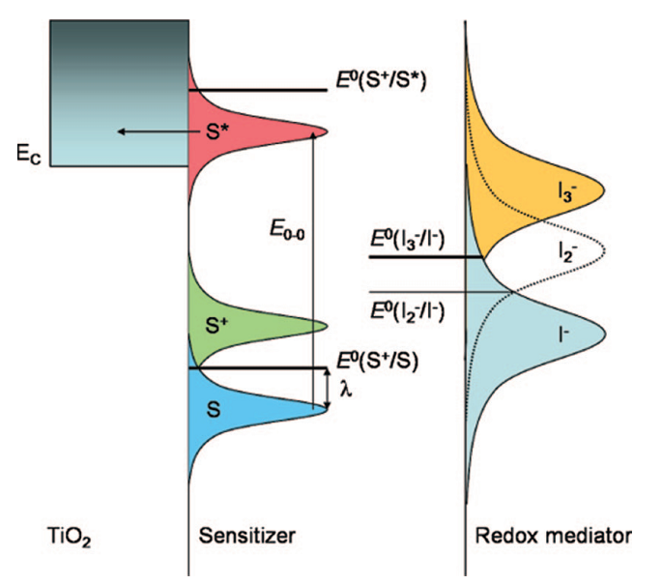
Working Principles
Energy Levels in Semiconductors
Energy Levels of Redox Systems in Solution
That is V_{OC}?
V_{OC}~E_{F}(TiO₂)-E_{F}(Red/Ox)

Slide 5
Types of Devices
Liquid-state DSSC’s.
contains active Red/Ox system like 3I⁻/I₃⁻, Co²⁺/Co³⁺ etc. in high polar solvent
like CH₃CN, MeOCH₂CH₂CN etc.
Solid-state DSSC’s
contains solid hole transporting layer like spiro-MeOTAD and Ag, or Al layer
+
Easy to assemble
High efficiency
-
Solvent leakage
Low efficiency at low temperature
Many component system
+
Highest efficiency (15.7%!!!)
No solvent
Flexibility
-
Vacuum process
High sensitivity to UV and air
Limitations by the pores filling

Slide 6
Red/Ox systems
Most popular is iodine based Red/Ox system: 3I⁻/I₃⁻
Increase E_{F} of TiO₂
and led to higher V_{OC}
KI + I₂ + CH₃CN
MeImI + I₂
+ Li-salt + additives
Improve charge injection into CB of TiO₂
Better conductivity in electrolyte
Other Red/Ox systems:
SCN⁻/(SCN)₃⁻, SeCN⁻/(SeCN)₃⁻, Fe²⁺/Fe³⁺, Co²⁺/Co³⁺
Organic Red/Ox systems

Slide 7
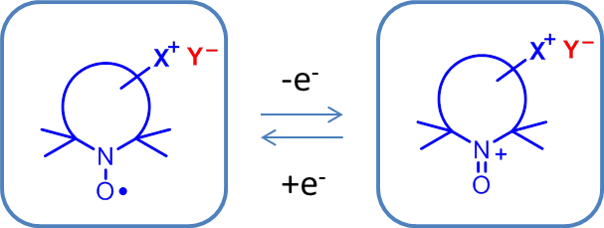

Nitroxides as Red/Ox systems
e⁻
D⁺/D*
cbTiO₂
hν
D⁺/D
Red/Ox
electrolyte
SnO₂:F
SnO₂:F
TiO₂ + dye
Pt
More positive E_{Red/Ox}
Low absorbance in visible range of spectra
High variety of properties e.g. E_{Red/Ox} and diffusion.
Non-corrosive

Slide 8
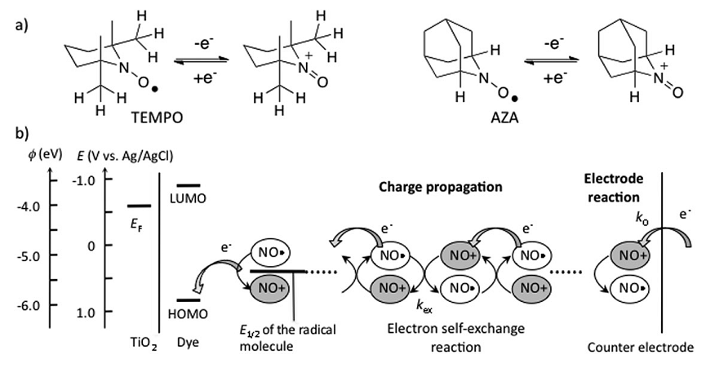
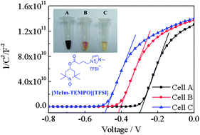
Nitroxides as Red/Ox systems
PCE=7.0%
PCE=8.6%
PCE=8.7%

Slide 9
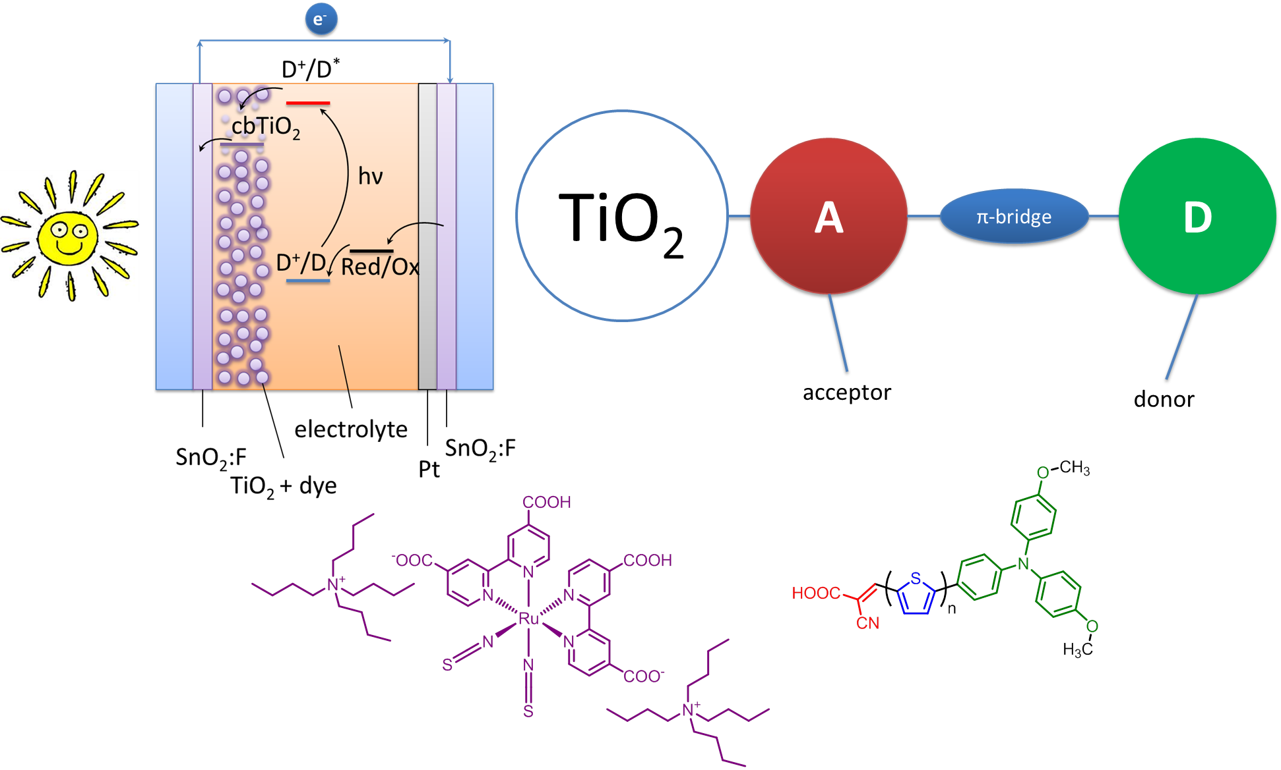
Sensitizers

Slide 10
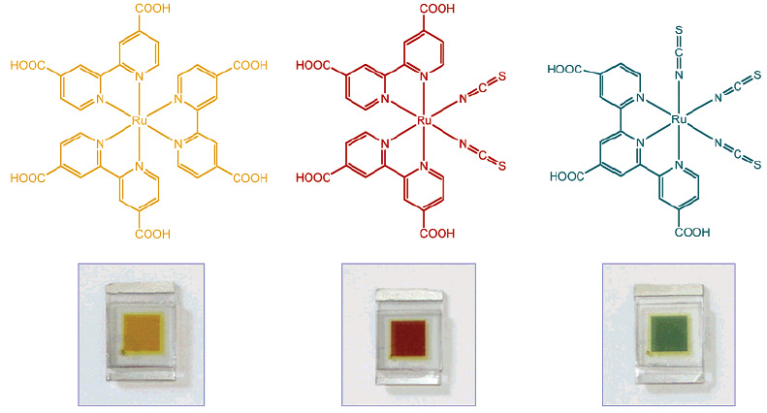
Ru-Dyes For Dye-Sensitized Solar Cells
Michael Gratzel,
Solar Energy Conversion by Dye-Sensitized Photovoltaic Cells,
Inorg. Chem., 44 (20), 6841-6851, 2005

Slide 11
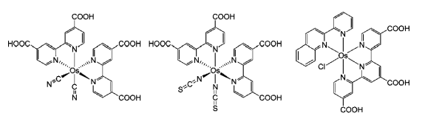

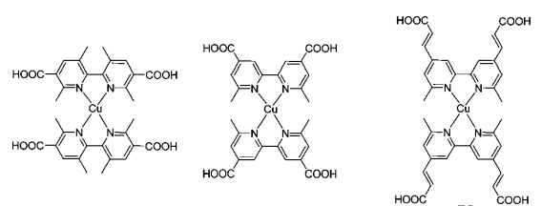
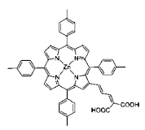
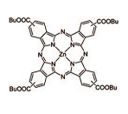
Other Complex Sensitizers

Slide 12
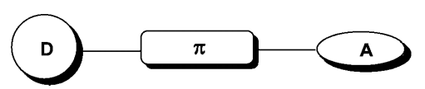

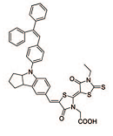
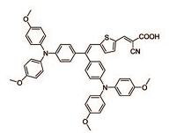


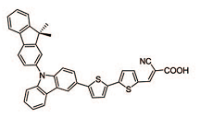
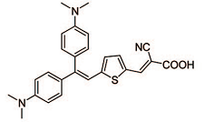

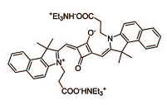
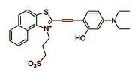
Pure Organic Sensitizers

Slide 13
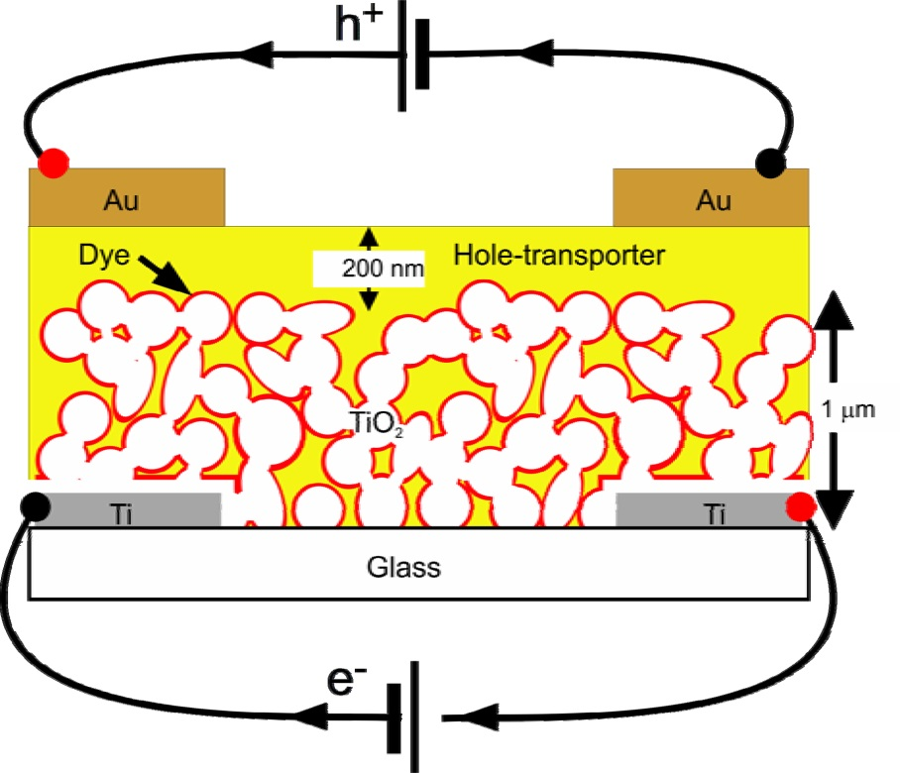
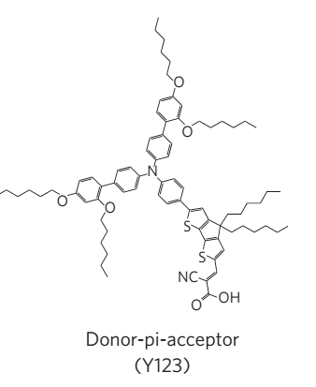
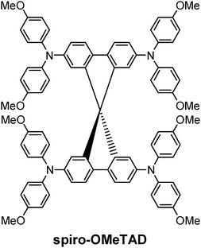
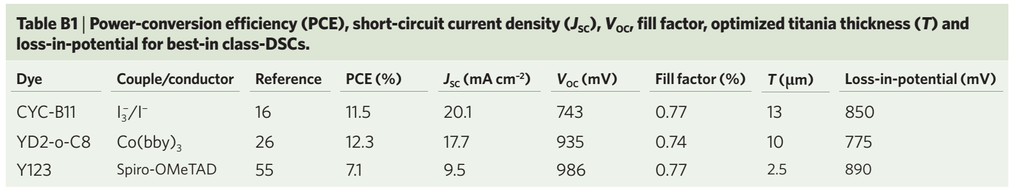
Solid-state DSSC’s.
Hole conducting material

Slide 14
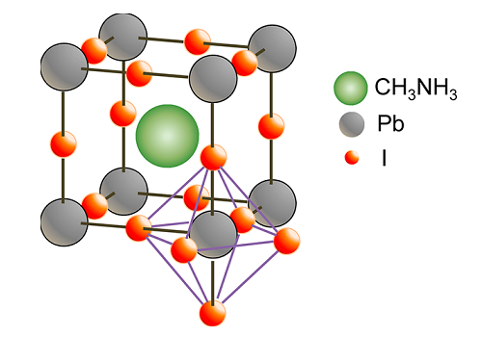
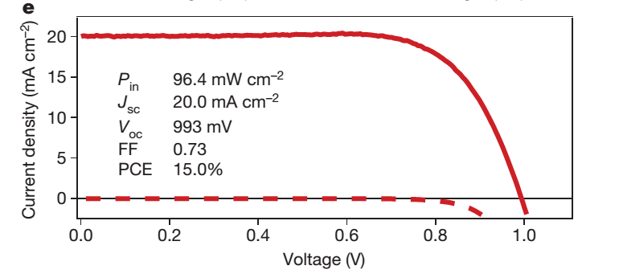
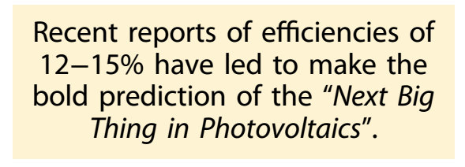
Pervoskite DSSC
PbI₂ + CH₃NH₃I

Slide 15
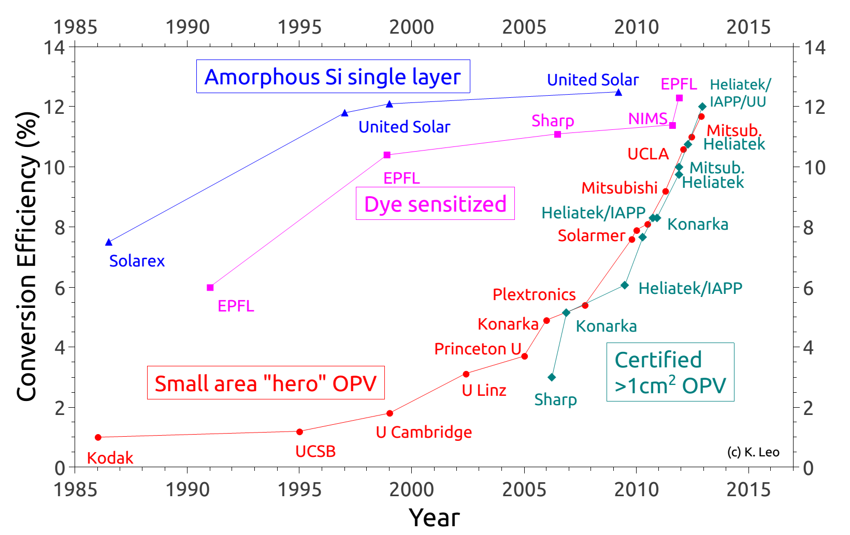
World efforts

Slide 16
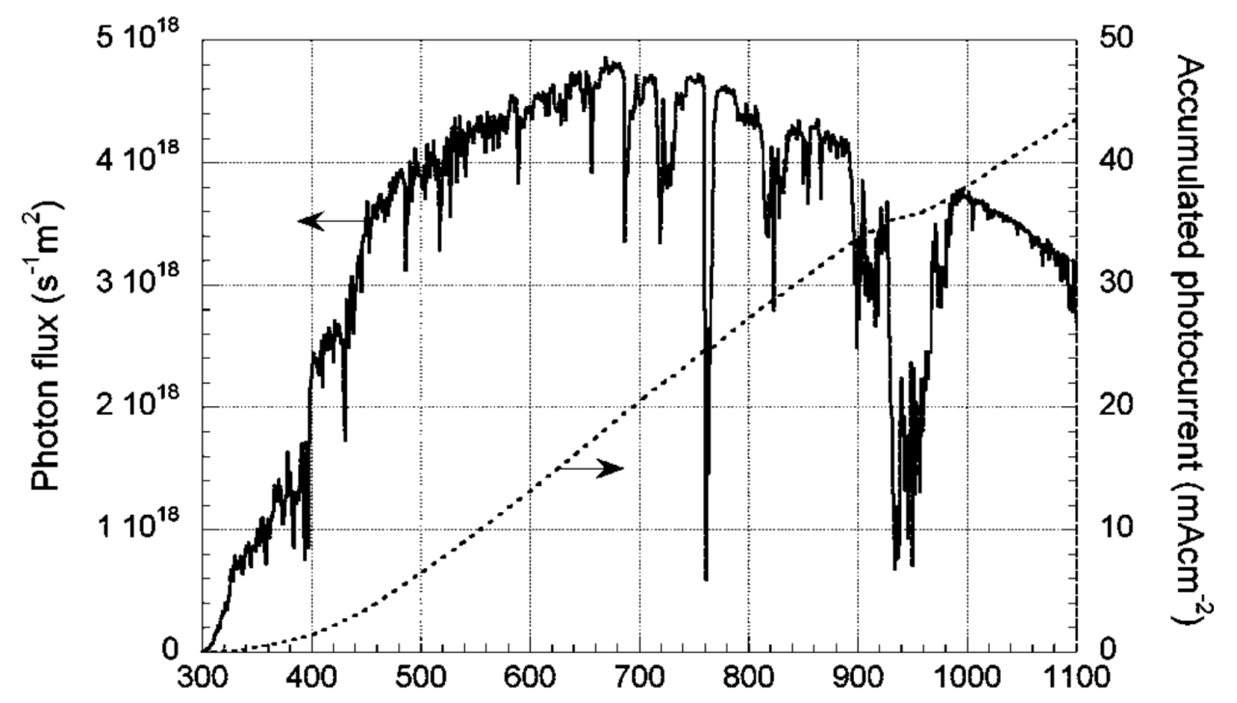
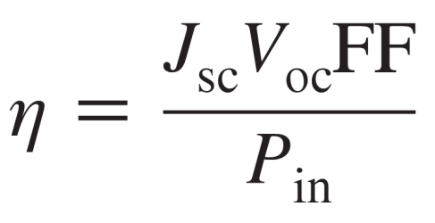

PCE Measurements

Slide 17
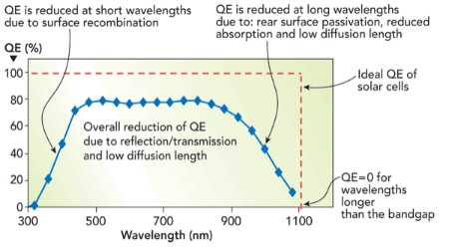
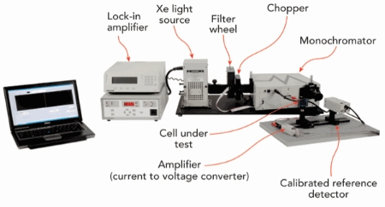
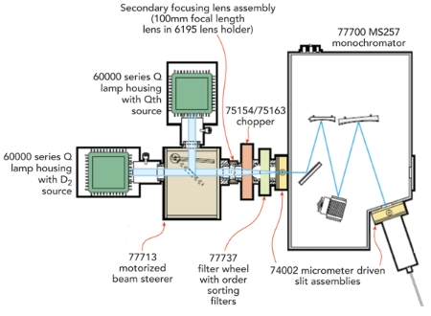

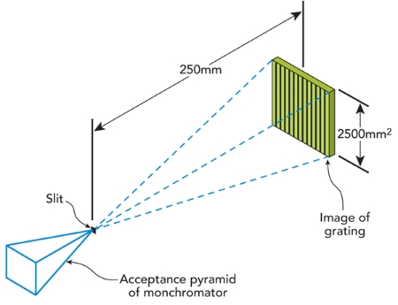
EQE Measurement

Slide 18
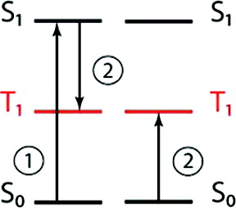
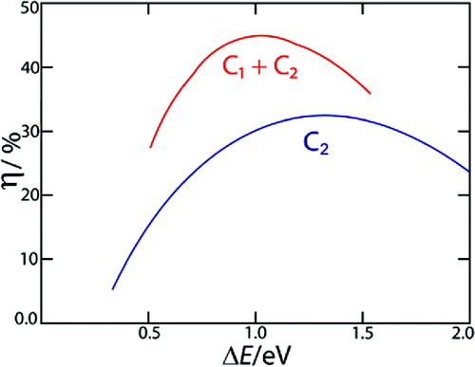
Singlet fission?
(1) The chromophore on the left undergoes an initial excitation to S1.
(2) The excited chromophore shares its energy with the chromophore on the right,
creating a T1 state on each.
Theoretical efficiency as a function of the S₀−T₁ band gap for a singlet fission solar cell defined (red) and a conventional dye-sensitized solar cell (blue)
Published in: Millicent B. Smith; Josef Michl; Chem. Rev. 2010, 110, 6891-6936.
DOI: 10.1021/cr1002613
Copyright © 2010 American Chemical Society

